Slide 1
Lecture 2. Wireless Channels (04/05)
1. Introduction
2. Review of Modulation Techniques | a. Principles of SS modulations b. General model of DSSS modulation c. Code orthogonality d. DSSS E Spread spectrum in CDMA
3. Mobile Radio Propagation | a. Propagation theory b. Free space propagation c. Wireless link power budget analysis
4. Basics of Antenna Theory
5. MAC in Wireless 802.11b LAN5 | a. Difference with wired Ethernet
6. Random Access Protocols
7. Motivation for a specialized MAC | a. WACA
8. MAC 802.11 Sub-layer Protocol | a. 802.11 bottom layers protocol stack b. 802.11 characteristics

Slide 2



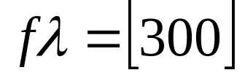
1.Introduction
The Electromagnetic Spectrum
Radio Transmission
Microwave Transmission
Infrared and Millimeter Waves
Lightwave Transmission
In vacuum, all electromagnetic waves travel at the same speed, no matter what their frequency. This speed is the speed of light-c, is about 1 foot (30cm)/ns. In copper or fiber the speed slows to about 2/3 of this value and is slightly frequency dependent.
The relation between frequency , wavelength , and speed –c is .
As a rule of thumb, when is in meters and is in MHz- .

Slide 3
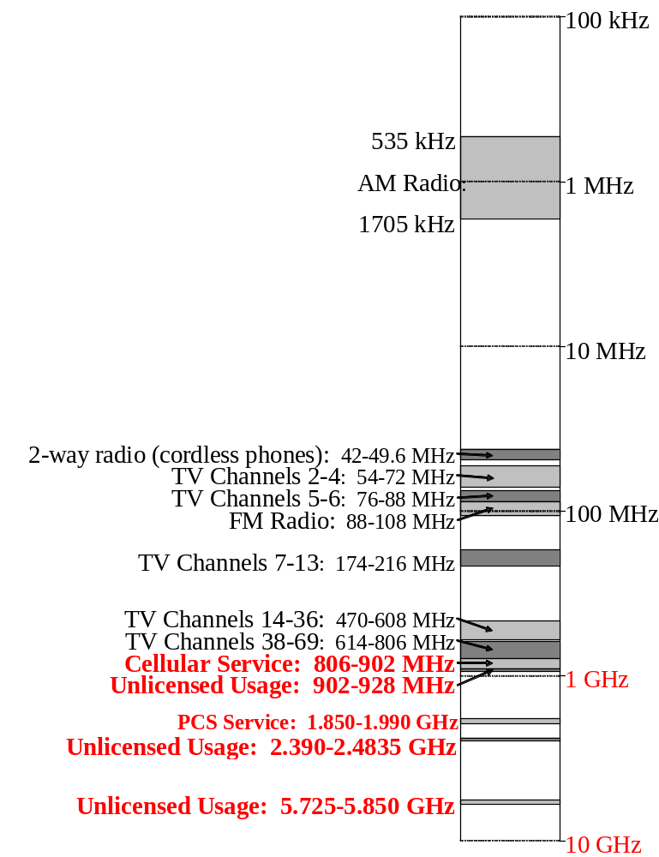
Radio frequencies in the 100 kHz to 10 GHz range.
microwave

Slide 4
2. Review of Modulation Techniques
1. Microwave voice/data transmissions: No AM.
Data-modulate the carrier wave using:
PM, FM, and SS modulation techniques.
2a. Links (channels) are separated with: FDMA.
Voice data-to encode signal digitally use: PCM
3a. Several voice signals in one channel
are separated by: TDMA

Slide 5
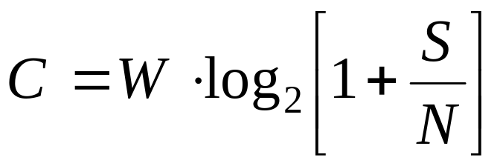
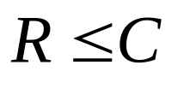
Shannon’s law shows the relationship between analog
Channel bandwidth and digital channel capacity:
When the SNR < below 1 (wireless channel is noisy channel), less than 1 bit can be transferred by each sample.
If the SNR ratio = 3, and the C=<2B.
Transmission Rate R is provided
Equality is achieved only when SNR is infinity
In practice: impossible to create an encoding scheme that
allows accurate transmissions near to the Shannon limit.
SS modulation allows to more closely approach the
Shannon's limit, by transmitting at a low SNR.

Slide 6
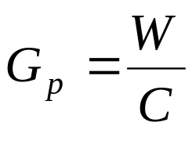
a. Principles of SS modulation
The most important parameter in any SS system is
the processing gain Gp:
This value measures the ratio of
Transmitted RF bandwidth W
to the narrowband information rate C.
A system with a low signal-to-noise ratio must have a high
processing gain Gp in order to recover the original signal.
Types of Spread Spectrum Modulation:
Direct Sequence Spread Spectrum (DSSS)
Frequency Hopping Spread Spectrum (FHSS)

Slide 7
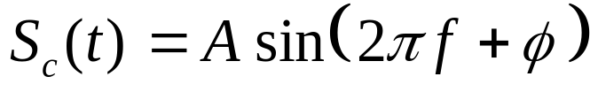
Modulation Techniques (cont)
A, φ, and f
BPSK: 0° or 180°,
QPSK 0°, 90°, 180°, 270°
A higher Kf value can be used in modulating the audio signal,
Higher Kf value decreases the signal error rate.
However, decoding an FM signal becomes very difficult at high Kf,
So we cannot increase Kf to use FM transmission in a wide frequency band.
In the radio spectrum, the available bandwidth exceeds the necessary data rate.
For instance, FM radio stations have about 100 kHz, bandwidth of an audio signal 20 kHz.
so, the processing Gain Gp =5
Spread spectrum techniques are necessary to for efficient use of a wide frequency band at low error rates.

Slide 8
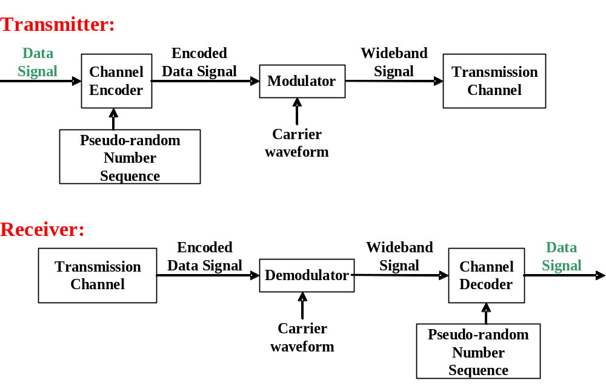
b. General model of DSSS modulations
W
C
Gp=W/C
BPSK or QPSK
“chipping”.

Slide 9
c. Code orthogonality
Two vectors called orthogonal if their inner product is 0 (Orthogonal in code space has the same meaning as in standard space). Code for a certain user should be orthogonal to other codes, and should have a good autocorrelation.
Two vectors (2,5,0) and (0,0,17); (2,5,0)*(0,0,17)=0+0+0=0; The vectors (1,2,3) and (4,2,-6) are not (inner product -10); (1,2,3) and (4,2,-3 are “almost” orthogonal (-1 which is close to zero).
Barker code (+1,-1,+1,+1,-1,+1,+1+1,-1,-1,-1), has good autocorrelation, (inner product with itself is large 11). But if this Barker code is shifted 1 chip, the correlation drops to a value of 1. It stays at this low until the code matches itself again perfectly. This helps to synchronize a receiver with the data stream. The matching process helps the receiver, to reconstruct the original data.
DSSS

Slide 10




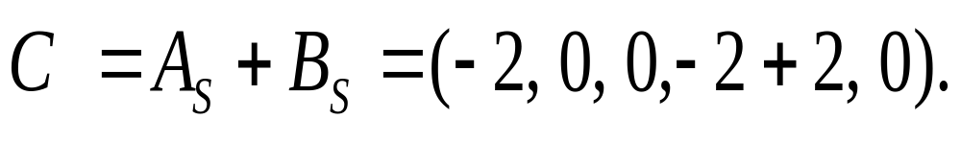
A and B, want to send data, CDMA assigns the following unique and orthogonal key sequences: Key for sender A,
Key for sender B. ; A wants to send the bit , sender B sends . To illustrate this example, let us assume that we code a binary 0 as -1, and binary 1 as +1. We can then apply the standard addition and multiplication rules. Both senders spread their signal using their key as chipping sequence (the term “spreading” here refers to the multiplication on the data bit with the whole chipping sequence).
Both signals are then transmitted at the same time using the same frequency, the signals superimpose in space. (No interference, no noise from this simple example), If the signals have the same strength at the receiver, the following signal C is received at a receiver
DSSS

Slide 11
Receiver now wants to receive data from sender A and, therefore, tunes in to the code of A, i.e., applies A’s code for dispreading:
DSSS
It is much larger than 0, the receiver detects a binary 1 (A has sent 1).
Tuning in to sender B, i.e., applying B’s code gives
The result is negative, so a 0 has been detected (B has sent bit 0).

Slide 12
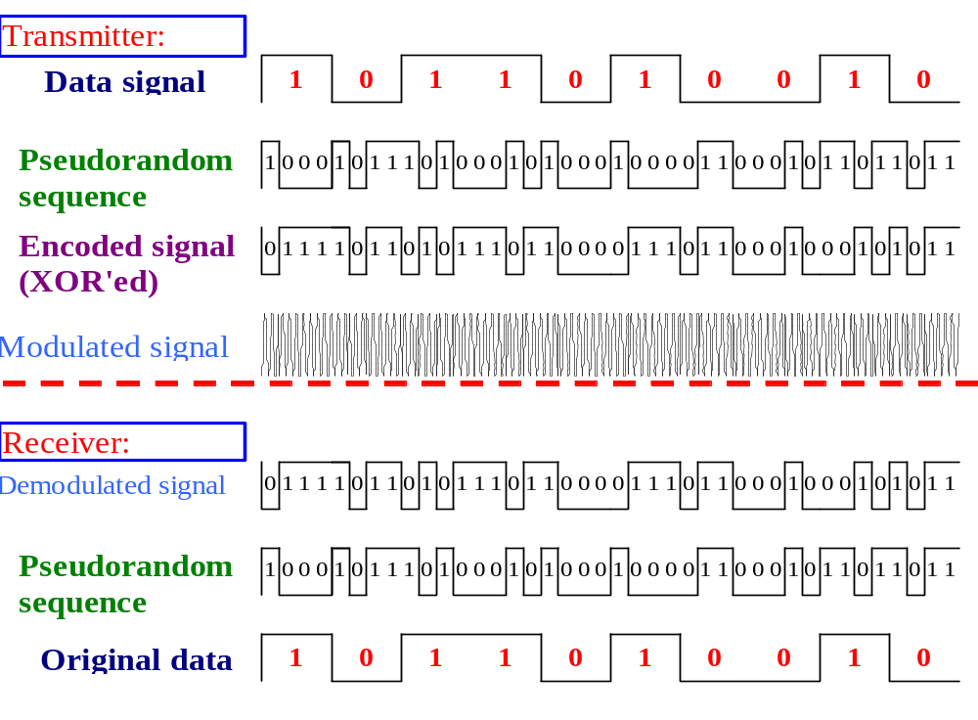
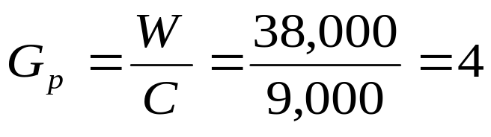
d. DSSS (Cont)
DSSS

Slide 13
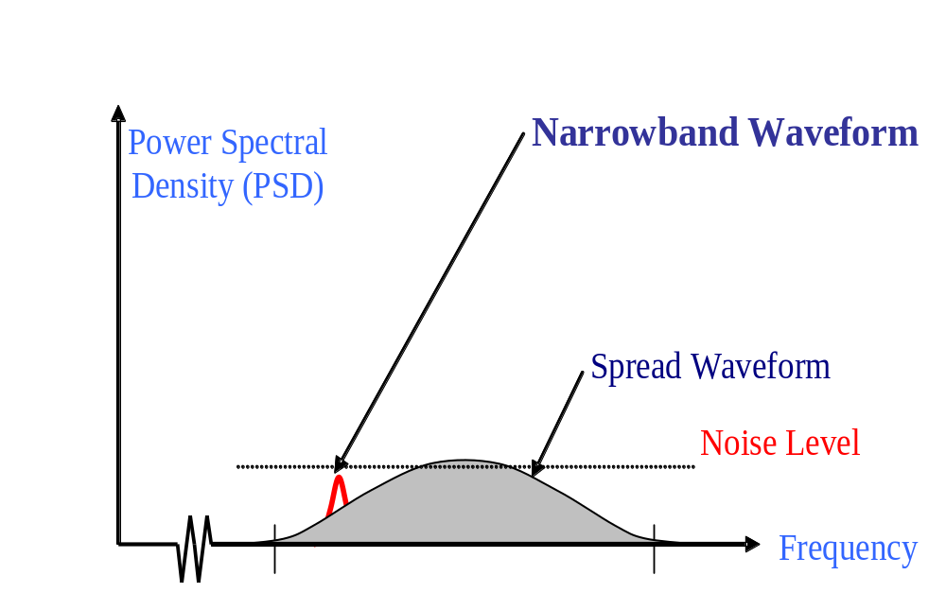
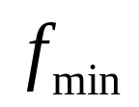
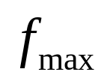
DSSS (Cont)
Gp is determined from: PN sequence bit rate / the data signal information rate.
For example: If the information signal is transmitted at 9600 bps. The PN sequence has a bit rate of 38,400 bps. The resulting, transmitted bit rate is 38,400 bps, so
DSSS

Slide 14
e. Spread Spectrum in CDMA
CELLULAR
CDMA: uses SS (DSSS or FHSS) encoding scheme
Unique code assigned to each user (code set partitioning) Used in wireless broadcast channels (cell., satellite)
All users in the same channel share the same frequency, but each user has own “chipping” sequence (i.e., code)
Chipping sequence used to encode the signal
Encoded signal =(original signal) X (chipping sequence)
To make CDMA work, chipping sequences must be chosen orthogonal to each other.
Global System Mobile (GSM) uses FM and TDMA

Slide 15

CDMA: two-sender interference
CELLULAR
1
2

Slide 16
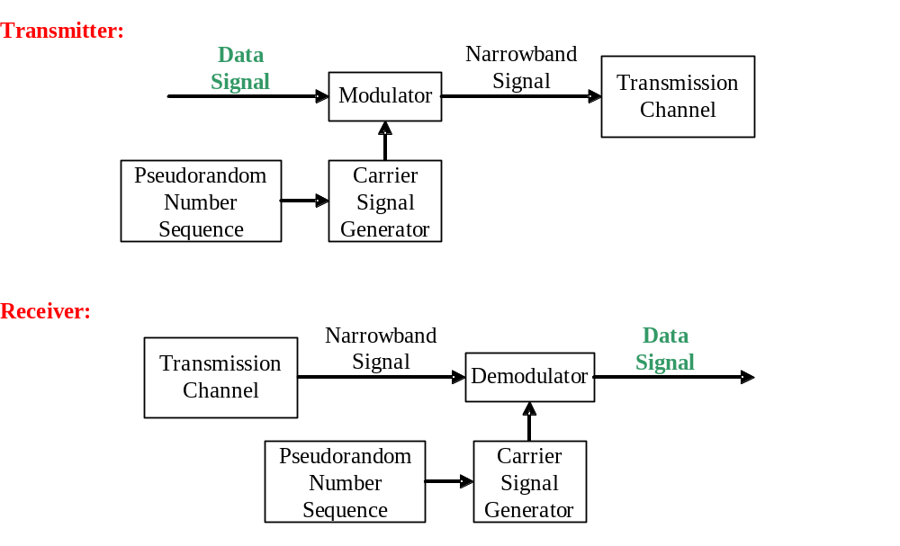
3. General model of FHSS modulation
“chipping”.

Slide 17
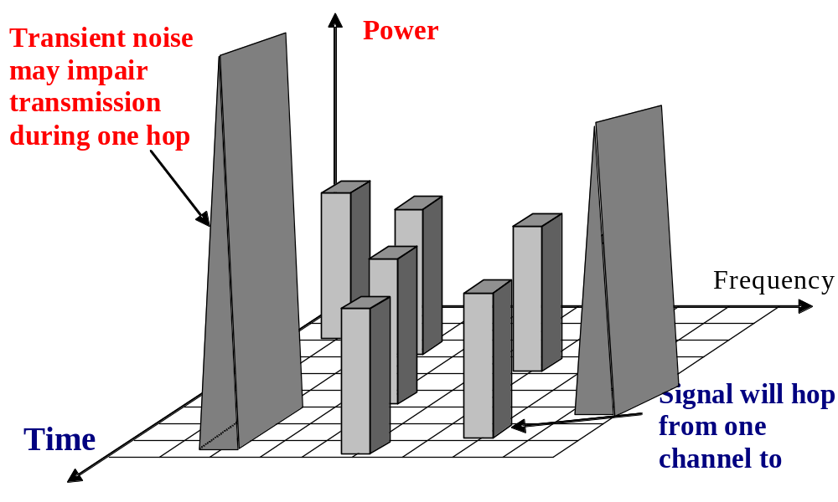
FHSS
1
2
3
4
FHSS is an ideal for a WLAN in a noisy frequency band !
4
During any one hop, the signal is vulnerable to noise in that frequency band, but it will soon move to another frequency with less noise. This new band will be sufficiently removed from the previous noisy band

Slide 18
FHSS-hops carrier frequency
If stations use the same PN number, they stay synchronized in time.
Dwell time, is an adjustable parameter, but must less than 400 msec.
They will hop to the same frequencies simultaneously
FHSS advantages for WLAN
WLAN systems can overlap without
interference
• Immunity from noise and
interference
• Resistance to radio reflections
(multipath transmission)
• High data transfer capacity
• Low price for TR and Rec
FHSS provides a security since an station, who does not know the hopping sequence or dwell time cannot overhear on transmissions.
P
23 for Japan
79 hops, each1-MHz wide
FHSS offers good resistance to multipath fading
GHz
2.4
2.483

Slide 19
4. Example: Bluetooth Frequency Hopping
1Mhz
. . .
1
2
3
79
83.5 Mhz
frequency hopping spread spectrum
  2.402 GHz + k MHz, k=0, …, 78
  1,600 hops per second
GFSK modulation
  1 Mb/s symbol rate
transmit power
  0 dBm (up to 20 dBm with power control)

Slide 20
5. Medium Access with CSMA/CA
When many users are located in the same area, and use the same wireless LAN at the same time, two different MAC methods are defined for signal multiplexing:
1. Distributed Coordination Function (DCF) (no control)
2. Point Coordination Function (PCF) (BS controls cell)
The basic access mechanism, called the DCF, Each unit senses the medium before it starts to transmit. If the medium is free for several microseconds, the unit can transmit for a limited time. If the medium is busy, the unit will back-off for a random time before it senses again.
It does not sense the channel while transmitting,

Slide 21
Medium Access with CSMA/CA (Cont)
The basic access mechanism:
DCF = CSMA/CA algorithm: 2 methods.
1). Physical channel sensing. 2). Virtual channel sensing
Physical channel sensing (PCS): Like Ethernet
It does not sense the channel while transmitting,
CSMA/CD needs full-duplex channel
802.11 all stations cannot hear each other
802.11 =802.3 + Positive Acknowledge Scheme
2. MACAW-Virtual Carrier Sense (VCS)

Slide 22
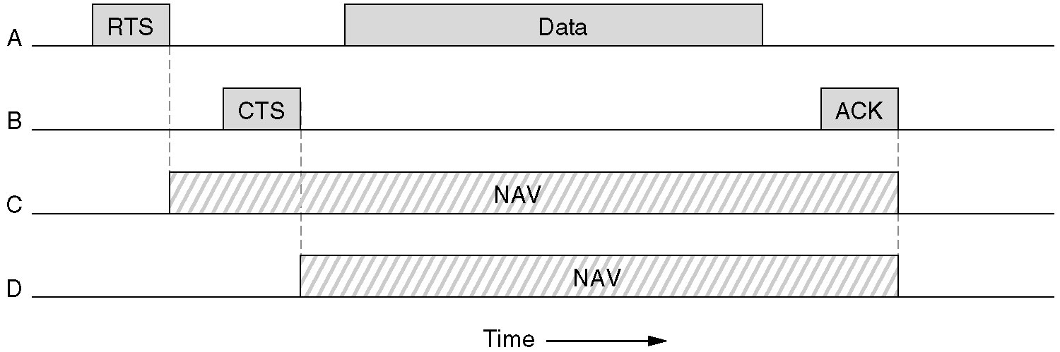
The 802.11 MAC Protocol (MACAW)
2. MACAW-Virtual Carrier Sense (VCS) using CSMA/CA.
NAV-Network Allocation Vector -keeps other stations quiet

Slide 23
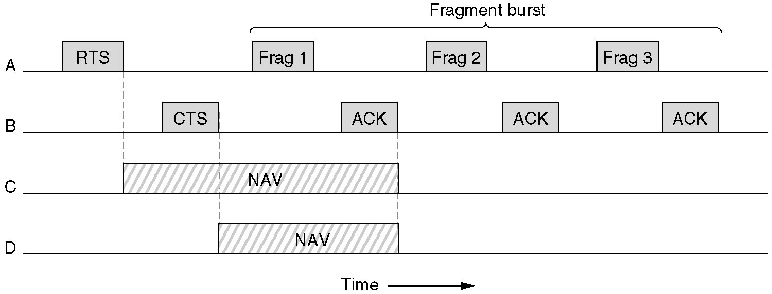
The 802.11 MAC Protocol:
fragments (MACAW)
2. DCF-The use of virtual channel sensing using CSMA/CA.
stop-and-wait protocol

Slide 24
a. Link characteristics of selected wireless network standards
a
200 Mbps
802.11n
802.11a,g
802.11a,g point-to-point
54 Mbps
5-11 Mbps
802.11b
W/MAX
4 Mbps
UMTS/CDMA, CDMA2000
3G
1 Mbps
802.15.1
3G
384 Kbps
IS-95, CDMA, GSM
56 Kbps
IS-95, CDMA, GSM
2G
Indoor Outdoor Mid range outdoor Long range outdoor
10-30 m 50-200 m 200-4 Km 5 Km-20 Km

Slide 25
Some characteristics of 802.11 WLAN
Characteristic | 802.11a | 802.11b | 802.11g
Topology | Physical star and a logical bus | Physical star and a logical bus | Physical star and a logical bus
MAC | CSMA/CA; Error control Stop-and-wait (S-a-W) | CSMA/CA; S-a-W (Stop and Weight) | CSMA/CA; S-a-W.
Data Transmission in the Physical Layer | D/A – A/D conversion, Combinations of BPSK, QPSK, And QAM modulations | D/A – A/D conversion, Combinations of PSK and QPSK modulation | D/A – A/D conversion. For 1 to 11 Mbps uses same modulations as 11 For 6 to 54 Mbps it uses the same modulations as 802.11a.
Rate; Mbps | 6; 9; 12; 18; 24; 36; 48; 54. | 1; 2; and 5.5 | 6-54
AP range, m | 15 to 50 | about 100 to 150 | 50–150
Frequency range and BW | 5-GHz. The total BW is 300 MHz, | 2.400 GHz - 2.4835 GHz = 83.5 MHz; | 2.4 GHz. Compatible with 802.11b
Separate radio frequency channels | 4–12 channels; 12 channels with 20 MHz BW is broken into 52 separate 312.5 KHz sub-channels, plus guard bands. 48 of thesub-channels for data; the four are for control. Data is sent across all 48 sub-channels in parallel using a OFDM. | 3 channels centered on: 2.412; 2.437; 2.462 GHz. with a 3-MHz guard- band | 3–6 channels depending upon configuration

Slide 26
6. Mobile Radio Propagation
Free space loss
Two ray model
Slow fading
Fast fading
Delay spread
Ground, Space, Sky, and Satellite waves

Slide 27
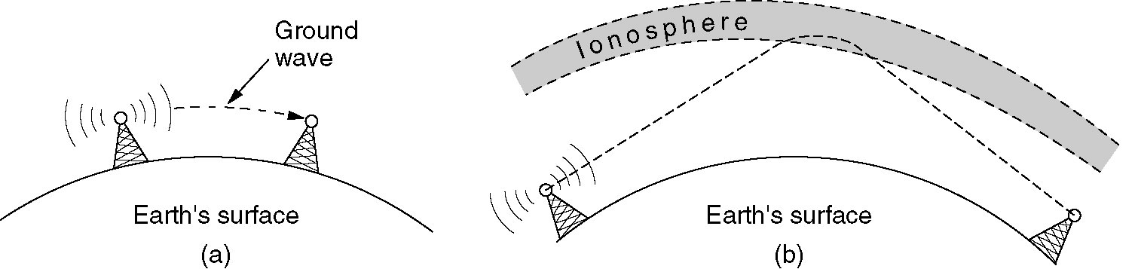
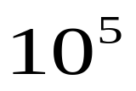


Radio Transmission (cont)
troposphere
Sky
(a) In the LF ( hertz), and MF ( hertz) bands, radio waves follow the curvature of the earth (ground).
(b) In the HF ( hertz) band, they bounce off the ionosphere (space).

Slide 28
Example 1
What is the period of the moon according to Kepler’s law?
Solution
The moon is located approximately 384,000 km above the earth. The radius of the earth is 6378 km. Applying the formula, we get
Period = (1/100) (384,000 + 6378)^{1.5} = 2,439,090 s = 1 month
Example 2
According to Kepler’s law, what is the period of a satellite that is located at an orbit approximately 35,786 km above the earth?
Solution
Applying the formula, we get
Period = (1/100) (35,786 + 6378)^{1.5} = 86,579 s = 24 h
A satellite like this is said to be stationary to the earth. The orbit, as we will see, is called a geosynchronous orbit.

Slide 29
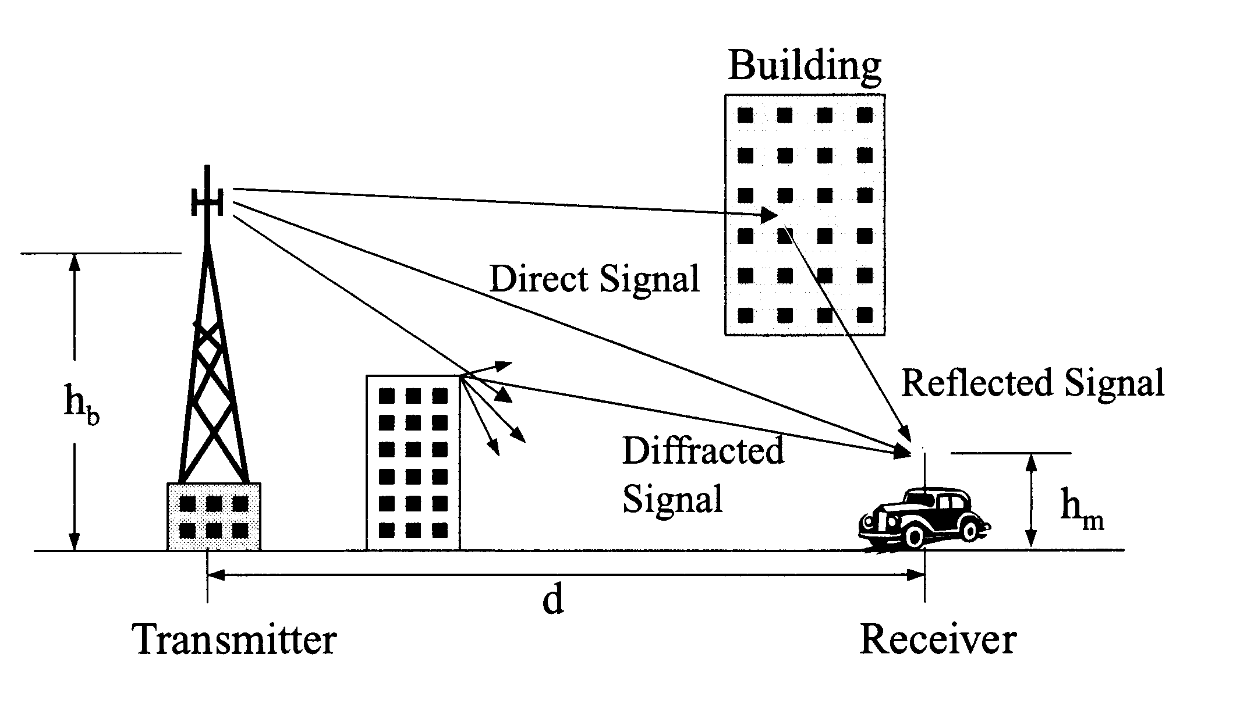
Scattering, Reflection and diffraction of radio signals
Scattering

Slide 30
a. Propagation mechanisms
Reflection: wave reflected by object larger than wavelength results Large-scale fading.
Scattering: wave hits loose objects smaller than wavelength; signal scattered in bunch of outgoing weaker signals are result Small-scale fading.
Diffraction: wave obstructed by surface with sharp, irregular edges.

Slide 31
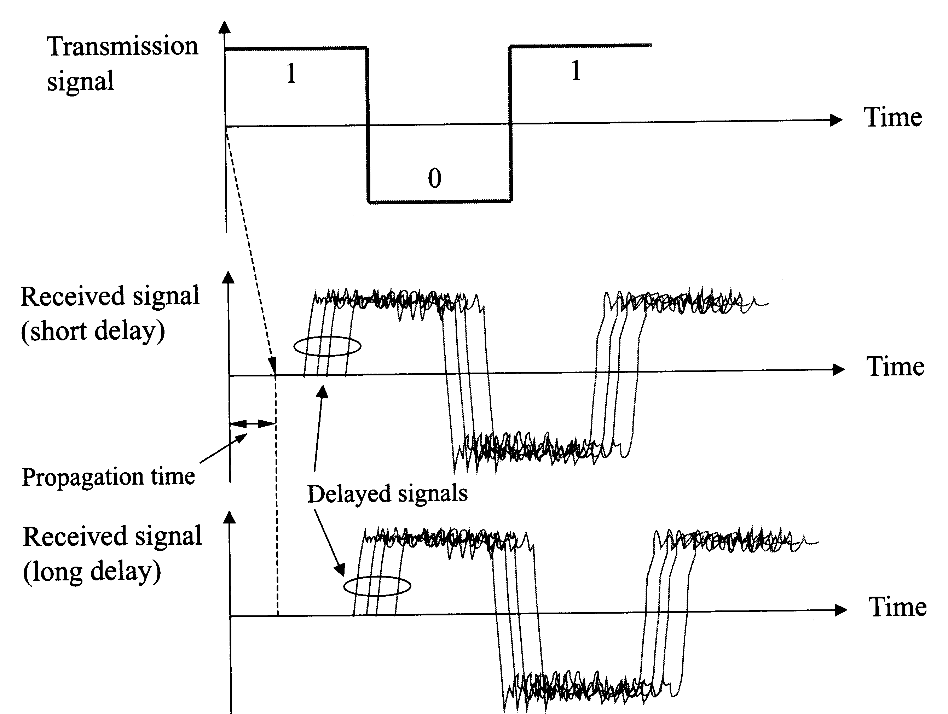
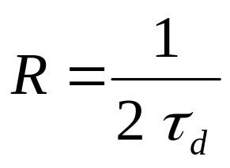
multipath signals, Intersymbol interference
In a time-dispersive medium the transmission rate R for a digital transmission is limited by the delay spread

Slide 32
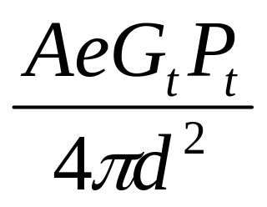
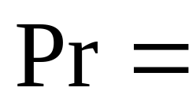
b. Free space propagation
Consider an isotropic radiation point source with power Pt. At distance d the radiated power is uniformly distributed over surface of a sphere.
Thus, received power Pr at distance d:
Ae = receiver antenna effective area
Gt = transmitter antenna antenna gain

Slide 33
Free Space Path loss (Lp)
Free space losses could be calculated by:
Note: loss increases with carrier frequency.
Lp = path loss (average propagation loss over wide area): Determined by distance, carrier frequency, land profile

Slide 34
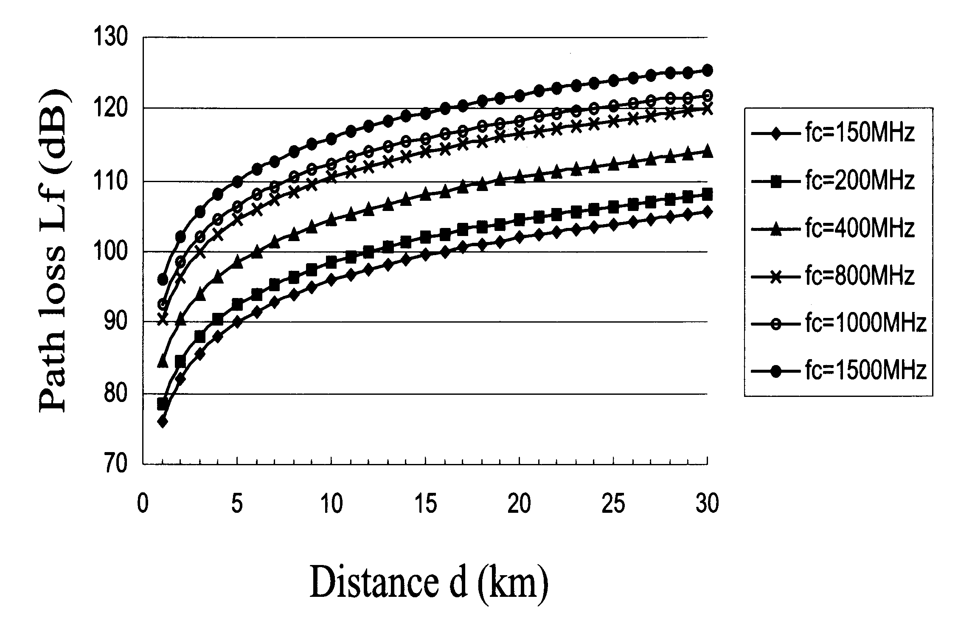
Free-space path loss (Cont)
1500 MHz
150 MHz

Slide 35
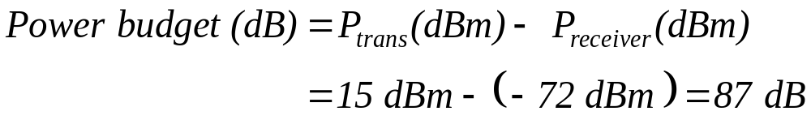
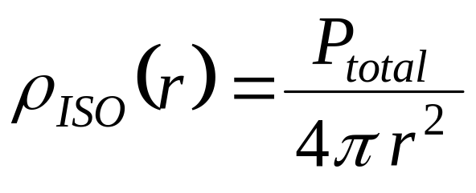
c. Wireless Link Power Budget Analysis
When operating at 3 Mbps, a WLAN system has transmission power of 15 dBm, and the receiver power must be at least –72 dBm. The communication power budget is therefore:
To find how transmission distance and frequency affect the power budget, we can calculate the free space isotropic loss. This is the path loss incurred by an electromagnetic wave as it propagates in a straight line through a vacuum from one isotropic antenna to another.
At any point around the antenna, the power density is:

Slide 36
Signal Loss Chart
Obstruction | Additional Loss (dB) | Effective Range | Approximate Range
Open Space | 0 | 100 % | 300 m
Window (non-metallic) | 3 | 70 % | 215 m
Window (metallic tint) | 5-8 | 50 % | 150 m
Wall (dry wall) | 5-8 | 50 % | 150 m
Wall (wood) | 10 | 30 % | 100 m

Slide 37


Slide 38
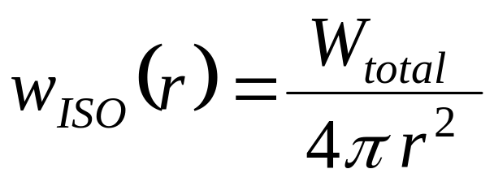
7. Appendix
Basics of Antenna Theory
Antenna reciprocity -A transmitting antenna will
transfer energy to the atmosphere with the same
efficiency with which it transfers energy from the atmosphere to its terminals, Antenna reciprocity.
Isotropic -If an antenna is a point source that radiates power equally in all directions.
Power density at any point of sphere would be total radiated power, divided by the area of this sphere:

Slide 39
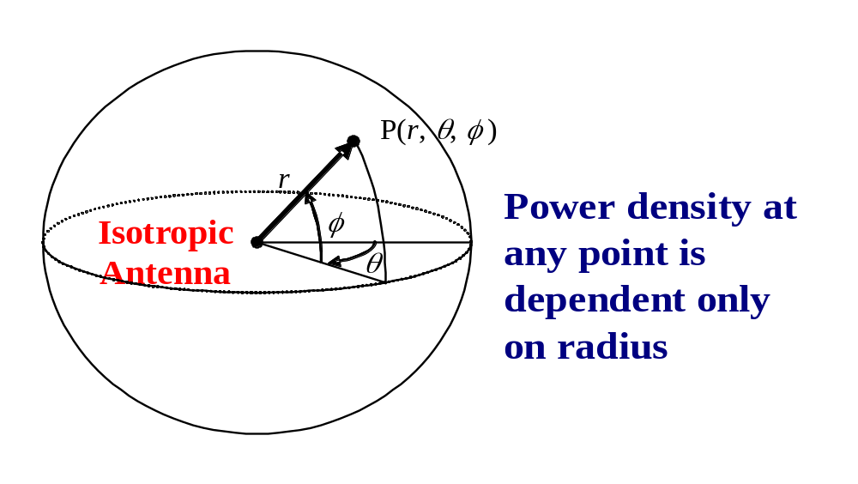
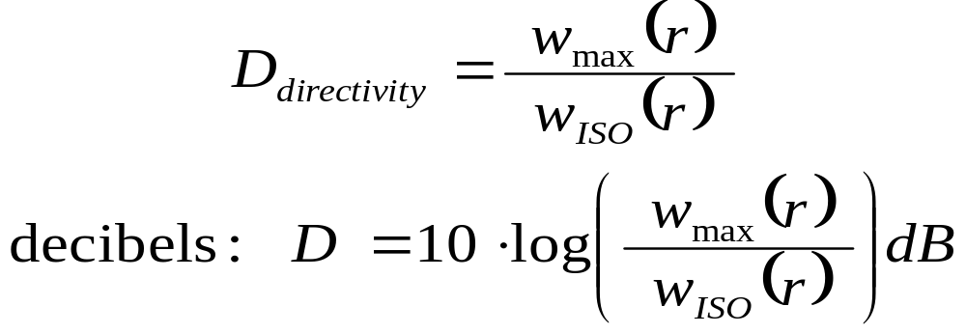
An isotropic antenna would radiate equally in all directions
For transmission antenna, the directivity of the antenna is the ratio of max power to isotropic power density. This ratio is usually expressed in decibels:
The power density is always dependent on the orientation of the receiver, which is measured in polar coordinates. The direction of maximum power density is assigned to θ = 0, φ = 0. This point is also called the foresight of the antenna.

Slide 40
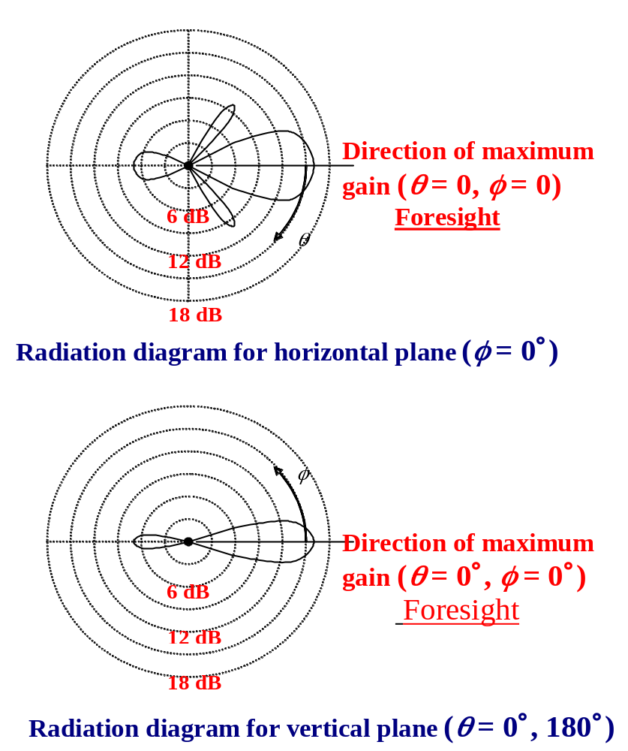
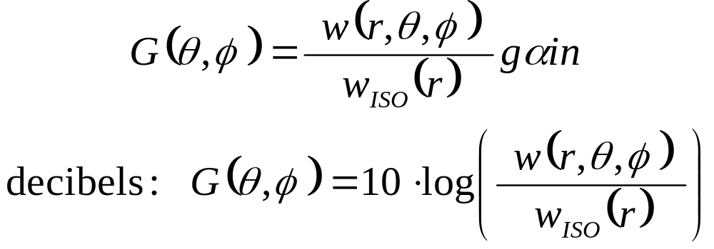
Transmission antenna (cont)
A radiation diagram describes the ratio of the antenna’s power density at any orientation around the antenna to the isotropic power density: or gain of the antenna in this direction.

Slide 41
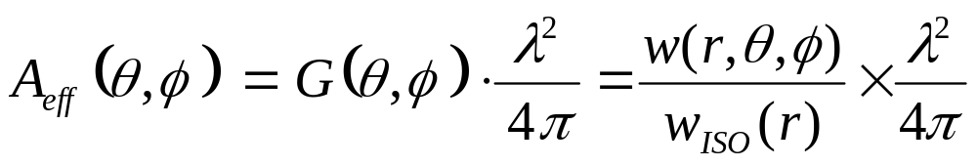
Receiving antenna (cont)
Effective area of the antenna measures how well the antenna captures power, and is simply the ratio of the power received by the antenna to the power density at the point where the antenna is located.
The effective area of the antenna can be much larger than the antenna geometric area. Because of the principle of reciprocity, the effective area of an antenna is related to the antenna gain by the following formula:

Slide 42
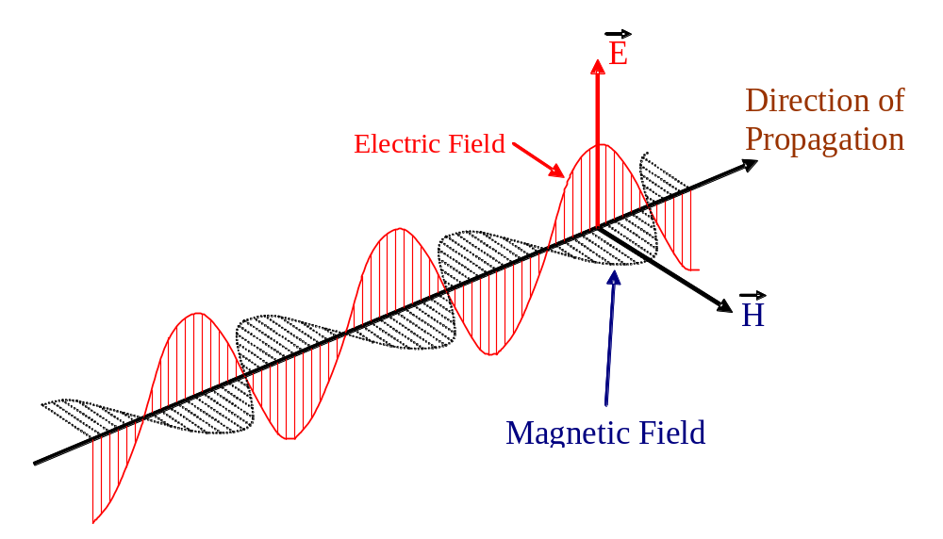
The polarization of the electromagnetic wave
Polarization describes the direction of the electrical field of the electromagnetic wave
There is also a perpendicular magnetic field, but we describe polarization in terms of the electric field.
An antenna generally has a preferred polarization direction, and it is important that the polarization of the transmitting antenna matches the polarization of the receiving antenna.

Slide 43
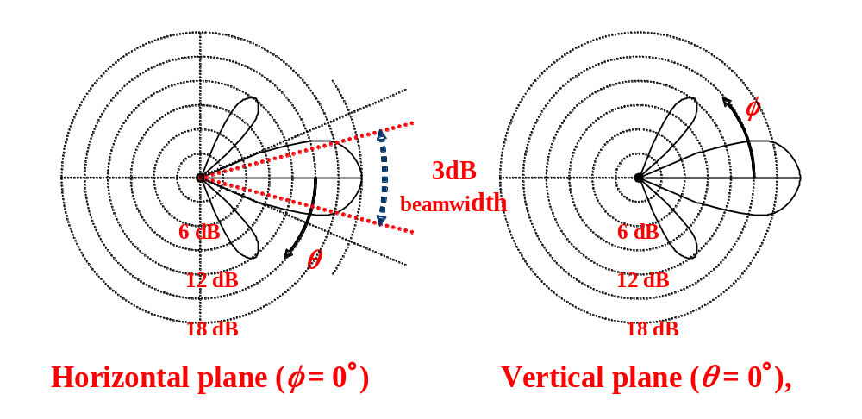
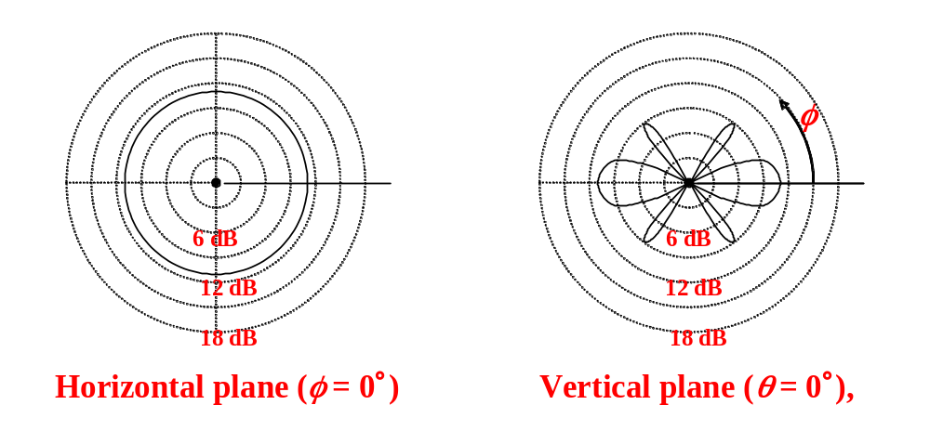
Directional antenna radiation pattern.
3 dB beamwidth, the angle between points that are 3dB below the max power output.
Omnidirectional antenna radiation pattern

